Slide 1
Geometry
Angle of Elevation & Depression and the Inverse of Sine, Cosine and Tangent
FA: BB- Ms. Johnson 2017/2018

Slide 2
Angles of Depression and Elevation
If you look up at an object, the angle your line of sight makes with a horizontal line is called the angle of elevation.
If you look down at an object, the angle your line of sight makes with a horizontal line is called the angle of depression.

Slide 3
Angles of Depression and Elevation
You are skiing on a mountain with an altitude of 1200 meters. The angle of depression is 21 degrees.
About how far do you ski down the mountain?
sin(21) = 1200/x
sin(21)(x) = 1200
x = 1200/sin(21)
x= (approx.) 3345.5

Slide 4
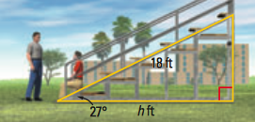
Angles of Depression and Elevation
Find the horizontal distance (h) that the bleachers cover.
cos(27)= h/18
cos(27)(18) = h
h = 16.04 feet

Slide 5
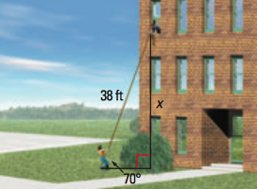
Angles of Depression and Elevation
You want to hang a banner from the third floor of your school but you need to know how tall the wall is and there’s a bush in your way.
sin(70) = x/38
sin(70)(38) = x
x = 35.7 feet

Slide 6
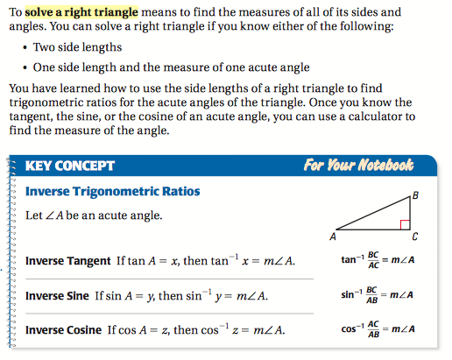
Solve Right Triangles

Slide 7
Side—-> Angle Measure

Slide 8
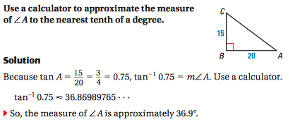
The Inverse of Tangent

Slide 9
The Inverse of Sine and Cosine

Slide 10
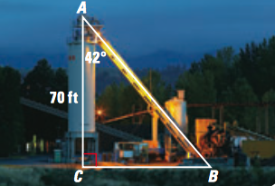
Solve a Right Triangle

Slide 11
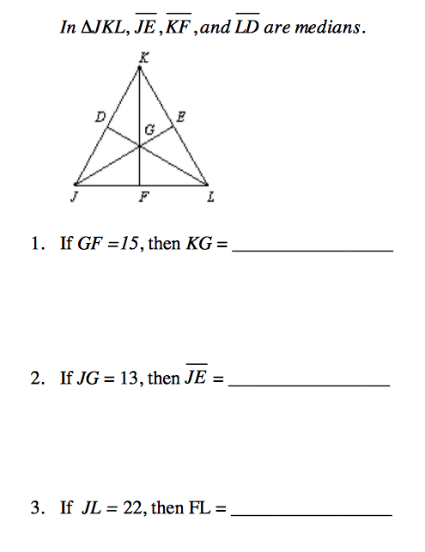
Median of a Triangle
A median of a triangle is a segment from a vertex to the midpoint of the opposite side.
Each median divides the triangle into two triangles of equal area.
Theorem 5.8
Concurrency of Medians of a Triangle
The medians of a triangle intersect at a point that is 2/3 of the distance from each vertex to the midpoint of the opposite side.

Slide 12
Incenter
The center of a triangle's "incircle" ... it is where the "angle bisectors" (lines that split each corner's angle in half) meet.

Slide 13
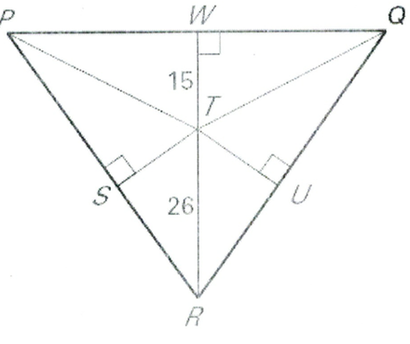
Incenter
What is ST?
If TU = (2x-1) find x

