Slide 1
Geometry
Use Medians and Centroids
FA: BB- Ms. Johnson 2017/2018

Slide 2
Median of a Triangle
A median of a triangle is a segment from a vertex to the midpoint of the opposite side.
Each median divides the triangle into two triangles of equal area.
Theorem 5.8
Concurrency of Medians of a Triangle
The medians of a triangle intersect at a point that is 2/3 of the distance from each vertex to the midpoint of the opposite side.

Slide 3
Centroid of a Triangle
The three medians a triangle are concurrent. The centroid is the intersection of the three medians, or the point of concurrency.
The three medians also divide the triangle into six triangles, each of which have the same area.

Slide 4
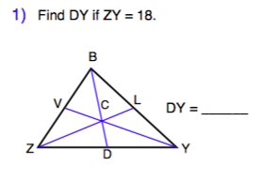
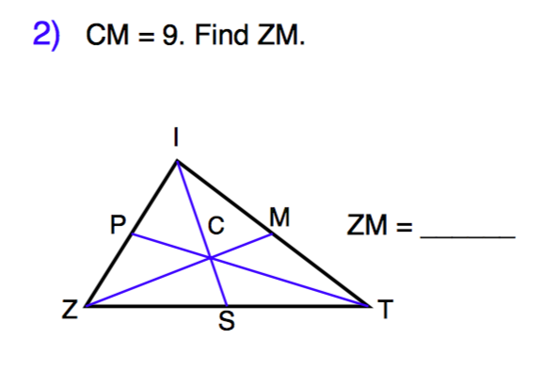
Finding Side Measures
If DY is half the measure of ZY, and ZY=18, then DY = 9.
If ZM is a median of the given triangle, that means the length of ZC is 2/3 of the total length of ZM. CM holds the remaining 1/3 length. If CM=9 then ZM=27

Slide 5
Finding Side Area
If Triangle APN’s area is 4 square inches, what is the area of Triangle ABC?
If APN=4 sq. in then ABC= 24 sq in
What is Triangle CPB’s area?
8 sq. in
What is Triangle ACL’s area?
12 sq. in

Slide 6
Isosceles Triangles
Each Isosceles Triangle has one vertex angle and two congruent base angles
We already know that if a triangle is classified as Isosceles it has two congruent sides. But what does that tell us about angle measure?

Slide 7
Isosceles Triangles
We already know that if a triangle is classified as Isosceles it has two congruent sides. But what does that tell us about angle measure?
Each Isosceles Triangle has one vertex angle and two congruent base angles

Slide 8
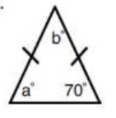
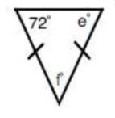
Finding Side Measures
What is the measure of angle a?
70 degrees
What is the measure of angle b?
40 degrees
What is the measure of angle e?
72 degrees
What is the measure of angle f?
36 degrees

