Slide 1
Geometry
SSS, SAS, ASA, AAS & HL
FA: BB- Ms. Johnson 2017/2018

Slide 2
Corresponding Parts
Recall that in order for lines or angles to be congruent, they had to have equal measures. In that same way, congruent triangles are triangles that have corresponding sides and angles that are congruent, which gives them the same size and shape.
Because side and angle correspondence is important, we have to be careful with the way we name triangles. For instance, if we state that Triangle ABC is congruent to Triangle DEF, it implies the following:

Slide 3
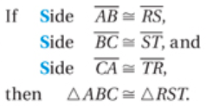
Proving Triangles Congruent
Side-Side-Side (SSS) Congruence Postulate
If three sides of one triangle are congruent to three sides of a second triangle, then the two triangles are congruent.

Slide 4
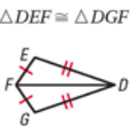
Is it possible to prove that these two triangles are congruent?
Side DE is congruent to Side DG- shown by the two dashes that are present.
Side EF is congruent to Side GF- shown by the single dash that’s present.
Side DF is congruent to side DF- shown by the fact that they are a shared side.
Yes; SSS

Slide 5
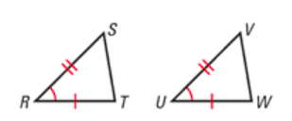
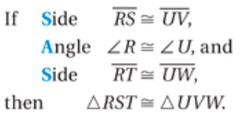
Proving Triangles Congruent
Side-Angle-Side (SAS) Congruence Postulate
If two sides and the included angle of one triangle are congruent to two sides and the included angle of a second triangle, then the two triangles are congruent.

Slide 6
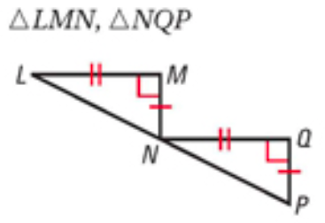
Is it possible to prove that these two triangles are congruent?
Side LM and Side NQ are congruent- shown by the two dashes that are present.
Angle M and Angle Q are congruent- both right angles.
Side MN and Side QP are congruent- shown by the single dash that is present.
Yes; SAS

Slide 7
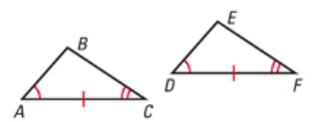
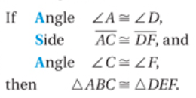
Proving Triangles Congruent
Angle-Side-Angle (ASA) Congruence Postulate
If two angles and the included side of one triangle are congruent to two angles and the included side of a second triangle, then the two triangles are congruent.

Slide 8
Is it possible to prove that these two triangles are congruent?
Angle P and Angle R are congruent- shown by two dashes within the angle.
Triangle PQR and Triangle RSP share a side- which shows congruence.
Angle R and Angle P are congruent- shown by one single dash within the angle.
Yes; ASA

Slide 9
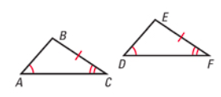
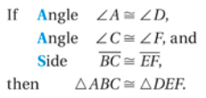
Proving Triangles Congruent
Angle-Angle-Side (AAS) Congruence Postulate
If two angles and non-included side of one triangle are congruent to two angles and the corresponding non-included side of a second triangle, then the two triangles are congruent.

Slide 10
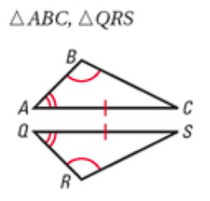
Is it possible to prove that these two triangles are congruent?
Angle B and Angle R are congruent- shown by the single arc within the angle.
Angle A and Angle Q are congruent- shown by the double arcs within the angle.
Side AC and Side QS are congruent- shown by the single dash on each side.
Yes; AAS

Slide 11
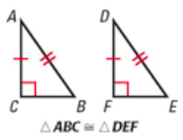
Proving Triangles Congruent
Hypotenuse-Leg (HL) Congruence Theorem
If the hypotenuse and a leg of a right triangle are congruent to the hypotenuse and a leg of a second right triangle, then the two triangles are congruent.
The hypotenuse of triangle ABC is congruent to the hypotenuse of triangle DEF.
Leg AC of triangle ABC is congruent to leg DF of triangle DEF.

Slide 12
Is it possible to prove that these two triangles are congruent?
The hypotenuse of triangle LMN is congruent to the hypotenuse of triangle SRL- shown by the two dashes present.
Leg MN is congruent to leg RL- shown by the single dash that is present.
Yes; HL

